Slide 1

Welcome to our class !

Slide 2
GAME: LUCKY GIFT BOX
There are four lucky gift boxes. Choose lucky gift box one by one.
Look at the pictures and point out what place in the pictures is.
Open the lucky gift box if the answer is correct.

Slide 3











Slide 4









You are given 5 candies
GO HOME

Slide 5
You are given mark 9
GO HOME

Slide 6
You are given a big clap hand
GO HOME

Slide 7
You are given a beautiful flower
GO HOME

Slide 8

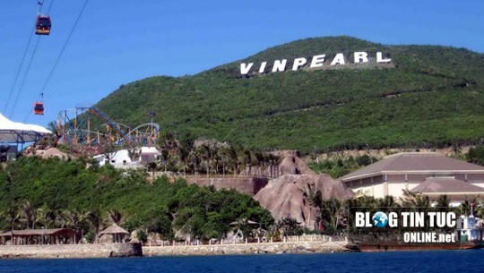
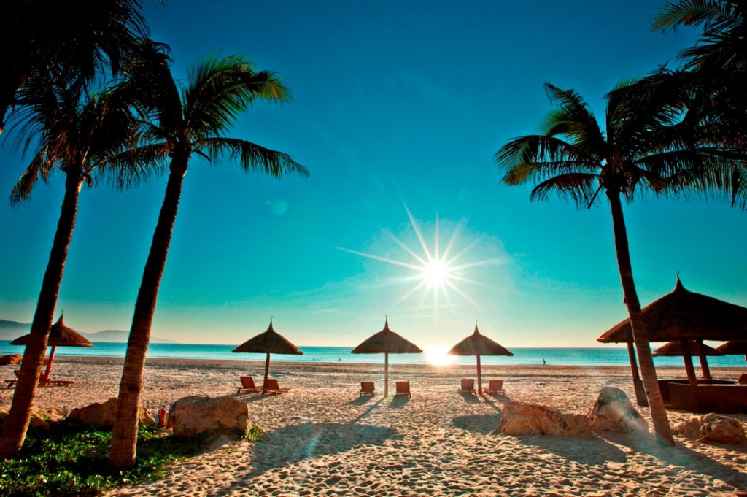
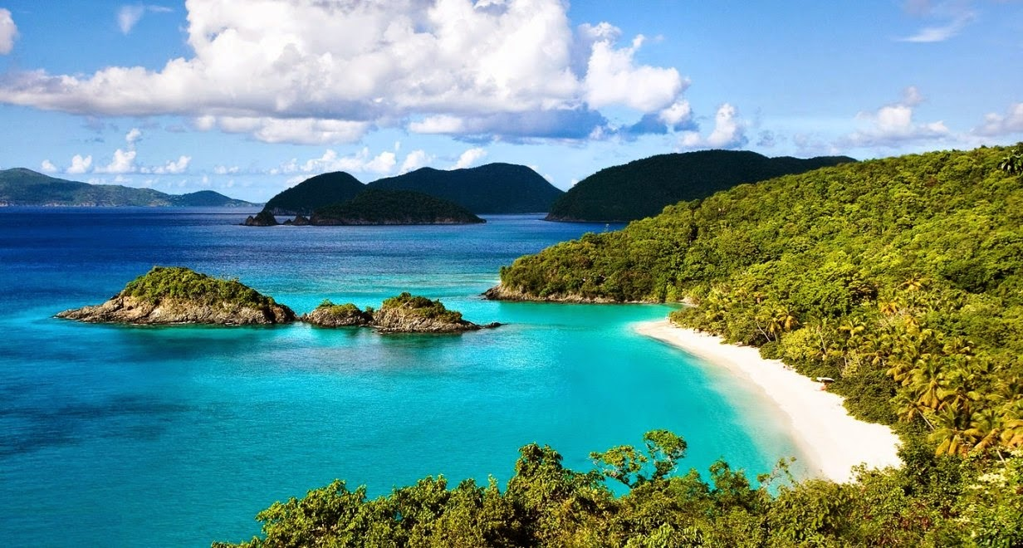
Nha Trang

Slide 9

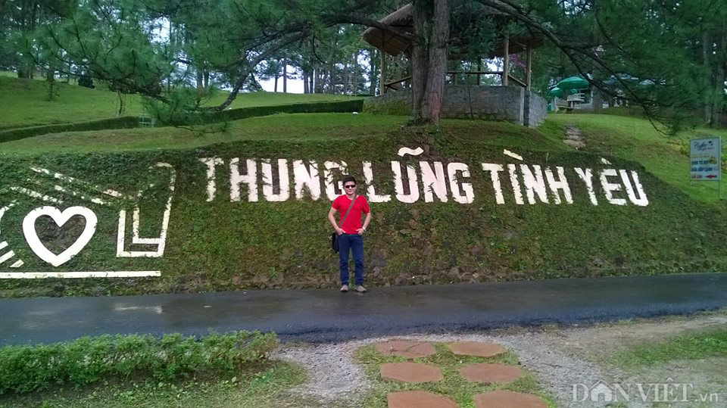
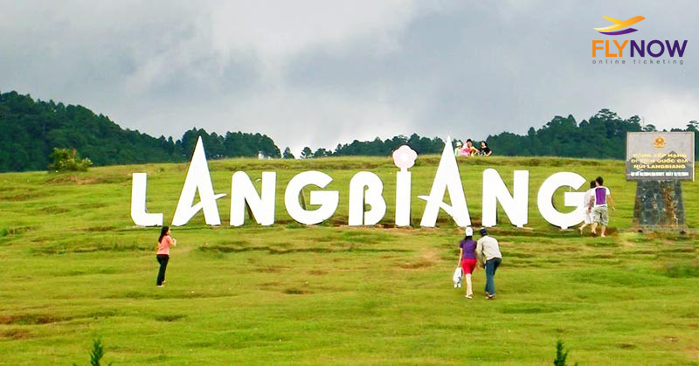
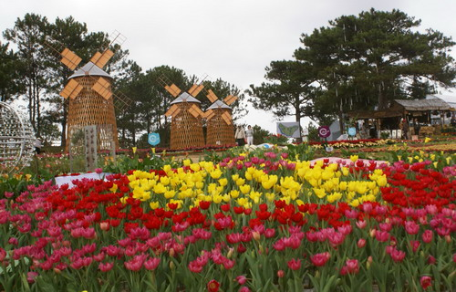
Da Lat

Slide 10

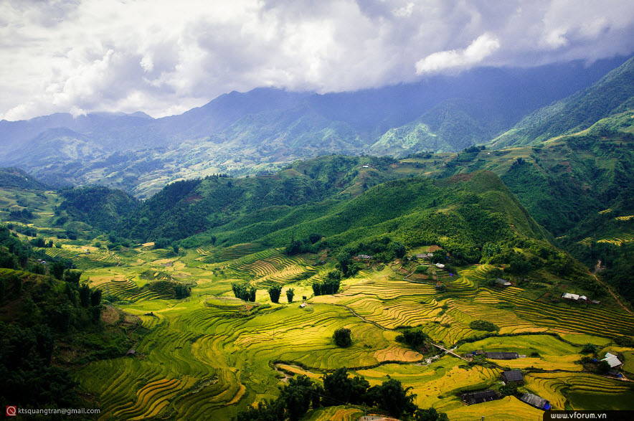
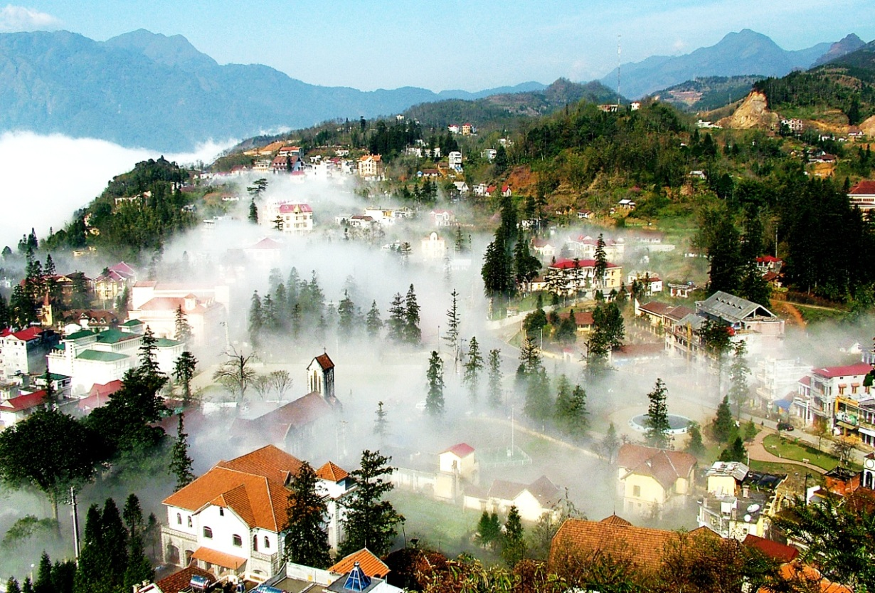
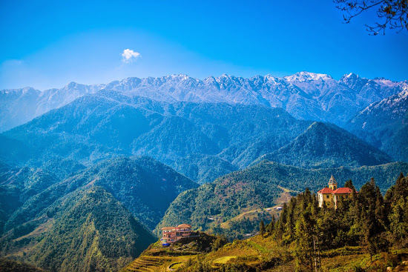
Sa Pa

Slide 11
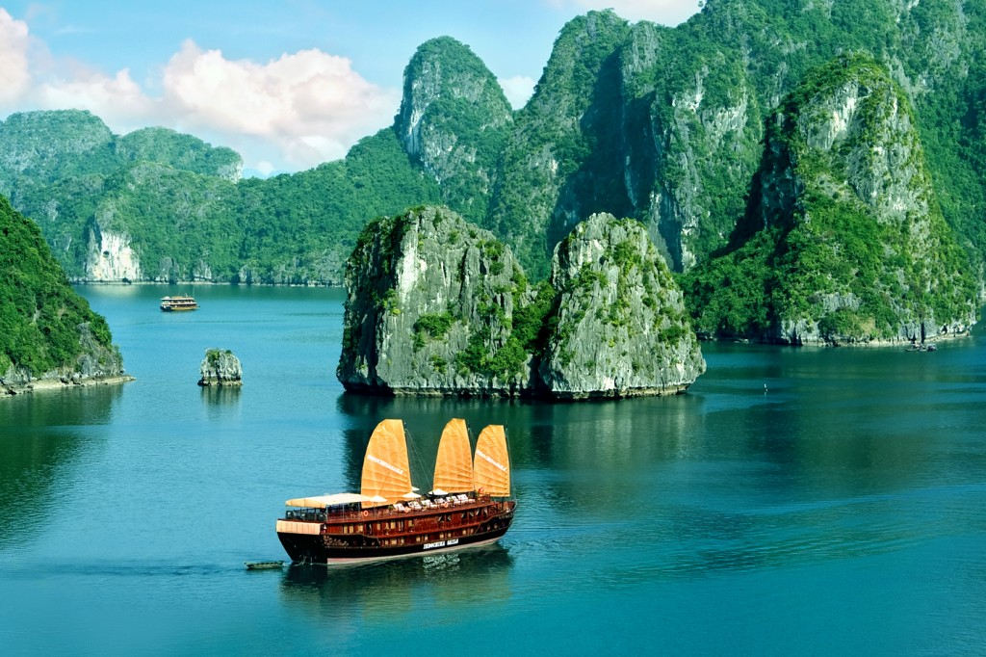
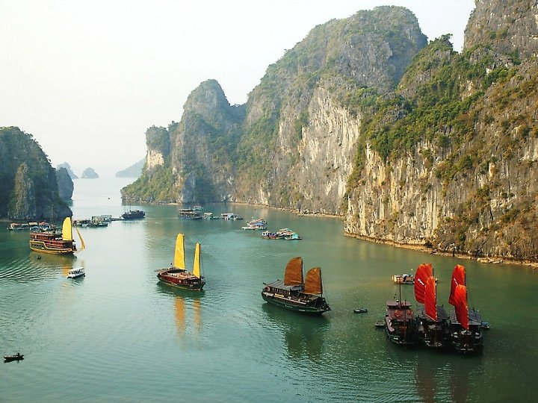
Ha Long Bay

Slide 12
Da Lat
Nha Trang
Ha Long bay
Sa Pa

Slide 13
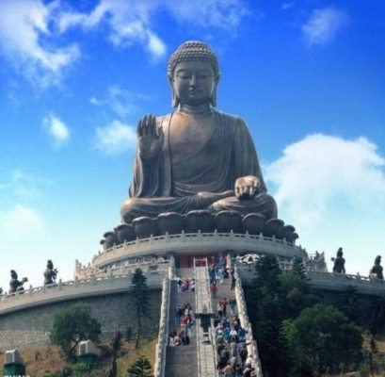
Giant = very big
/ˈdʒaɪənt/
Giant Buddha

Slide 14
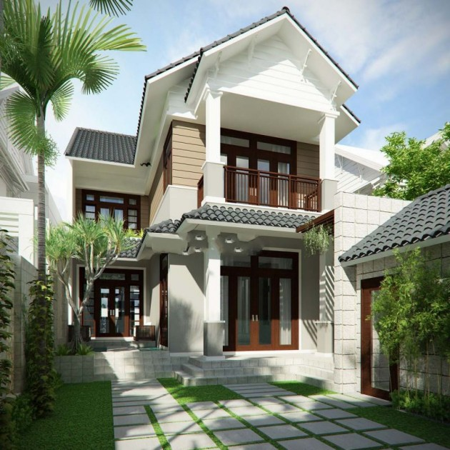
accommodation (n)
/əˌkɒməˈdeɪʃn/

Slide 15
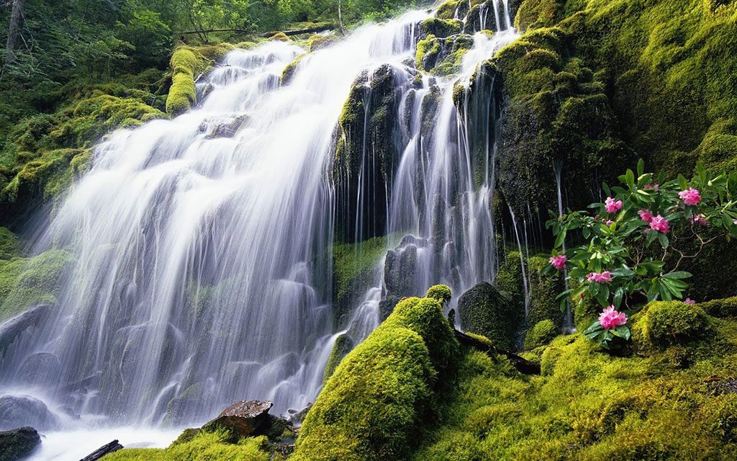
waterfall (n)
/ˈwɔːtərfɔːl/

Slide 16
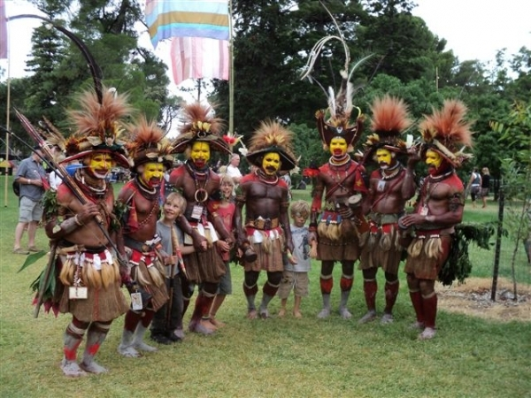
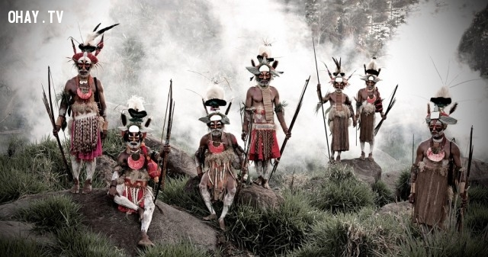
tribe (n)
/traɪb/

Slide 17
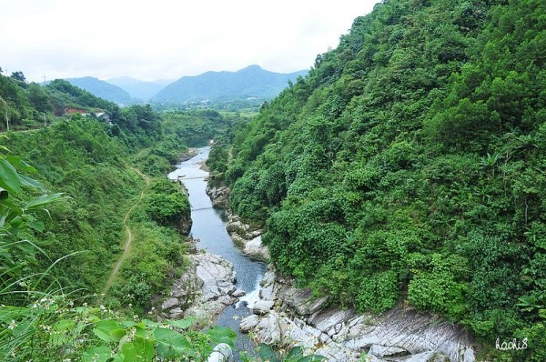
stream (n)
/striːm/

Slide 18
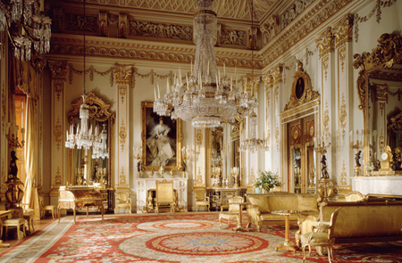
magnificent
(adj)
/mæɡˈnɪfəsnt/

Slide 19
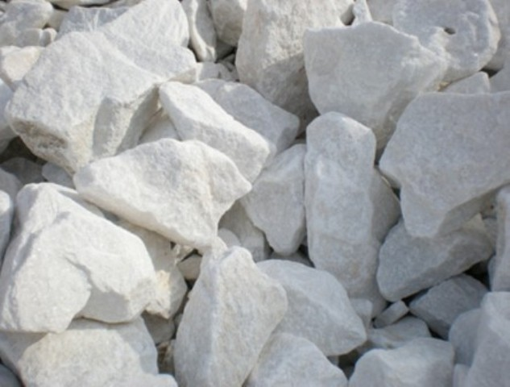
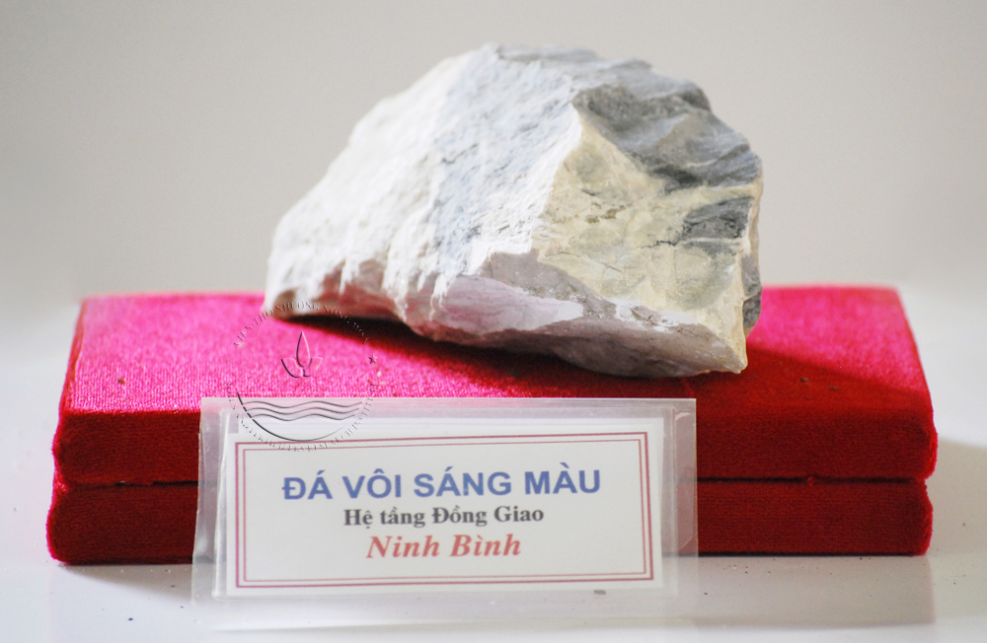
limestone (n)
/ˈlaɪmstəʊn/

Slide 20
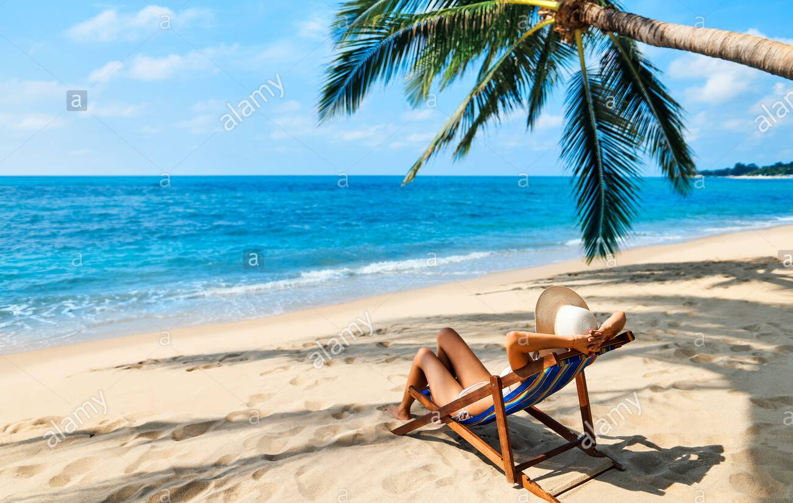
sunbathe (v) /ˈsʌnbeɪð/

Slide 21
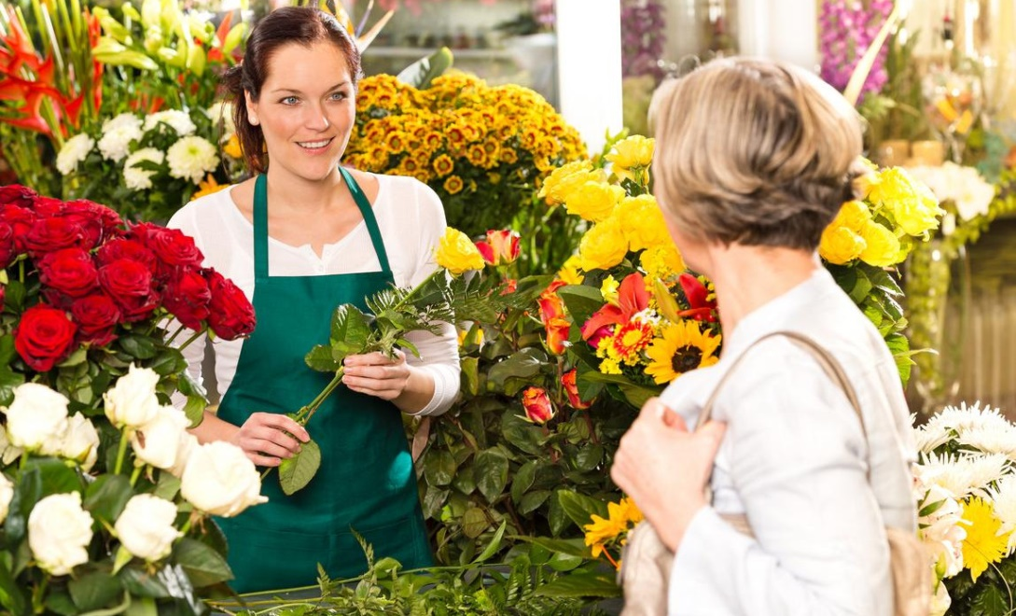
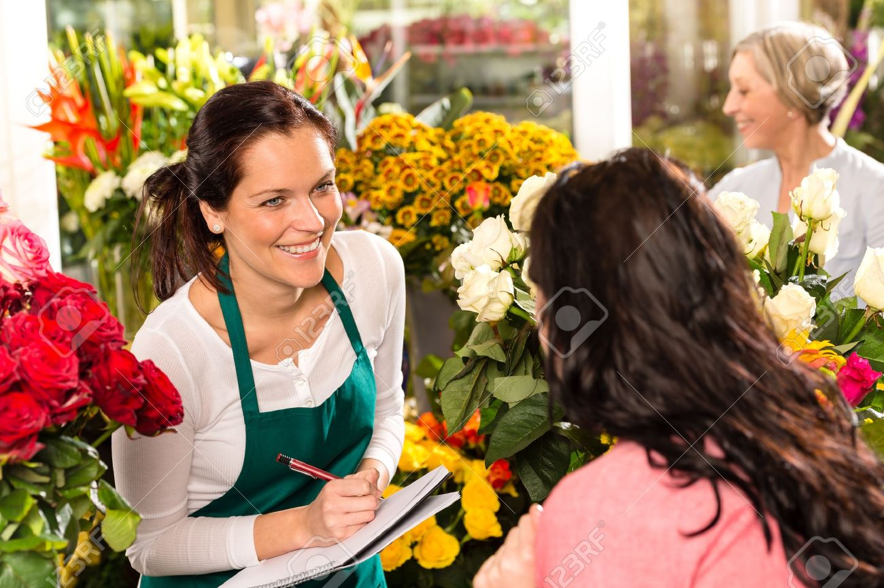
florist (n) /ˈflɔːrɪst/

Slide 22

True or false?
T
F
1. There are many offshore islands in Sa Pa.
2. In Ha Long Bay, there are magnificent caves.
3. Da Lat is one of the World Heritage Sites.
4. Visitors can see waterfalls in Da Lat.

Slide 23
True or false?
1. There are many offshore islands in Sa Pa.
2. In Ha Long Bay, there are magnificent caves.
3. Da Lat is one of the World Heritage Sites.
4. Visitors can see waterfalls in Da Lat.
T
F
F
→ There are many offshore islands in Nha Trang.
T
F
Ha Long Bay is one of the World Heritage Sites.
T

Slide 24
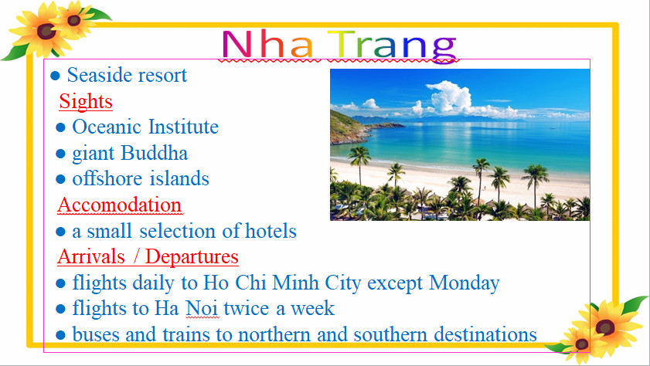
1. Check (✓) the topics:
 | Nha Trang
Caves
Flights to Ha Noi
Hotels
Local Transport
Mini-hotels
Mountain Slopes
Railway
Restaurants
Sand beaches
Tourist Attractions
Types of food
Villages
Waterfalls
World Heritage
✓
✓
✓
✓

Slide 25
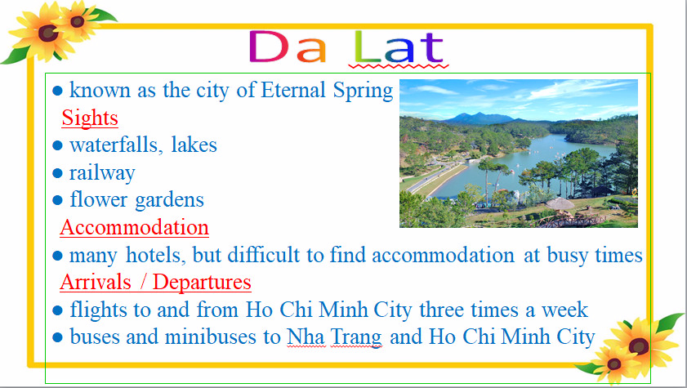
1. Check (✓) the topics:
 | Da Lat
Caves
Flights to Ha Noi
Hotels
Local Transport
Mini-hotels
Mountain Slopes
Railway
Restaurants
Sand beaches
Tourist Attractions
Types of food
Villages
Waterfalls
World Heritage
✓
✓
✓
✓
✓

Slide 26
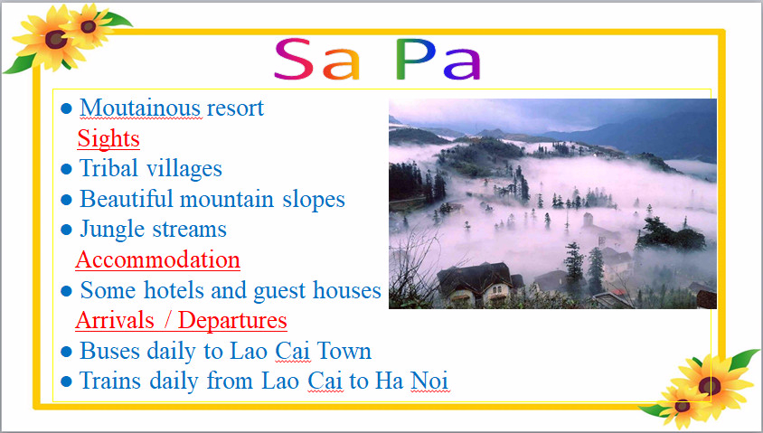
1. Check (✓) the topics:
 | Sapa
Caves
Flights to Ha Noi
Hotels
Local Transport
Mini-hotels
Mountain Slopes
Railway
Restaurants
Sand beaches
Tourist Attractions
Types of food
Villages
Waterfalls
World Heritage
✓
✓
✓
✓
✓

Slide 27
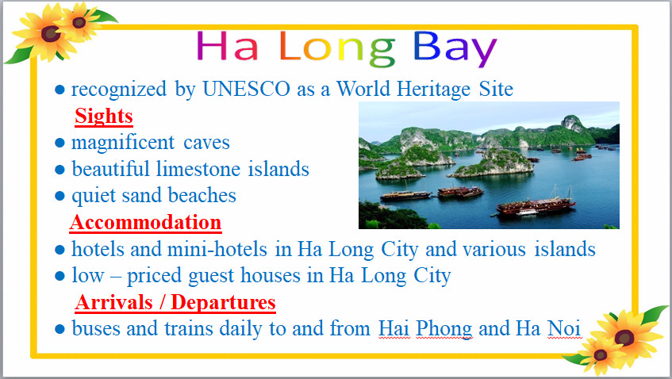
1. Check (✓) the topics:
 | Ha Long Bay
Caves
Flights to Ha Noi
Hotels
Local Transport
Mini-hotels
Mountain Slopes
Railway
Restaurants
Sand beaches
Tourist Attractions
Types of food
Villages
Waterfalls
World Heritage
✓
✓
✓
✓
✓
✓
✓

Slide 28


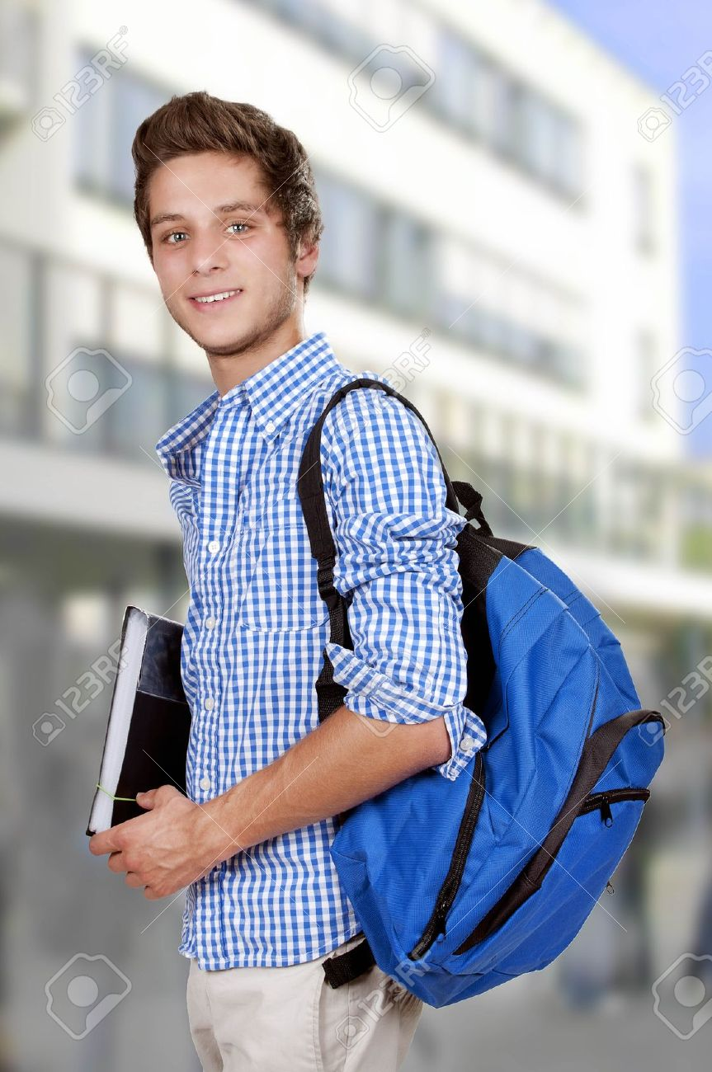
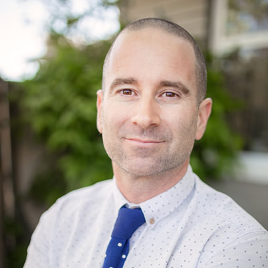
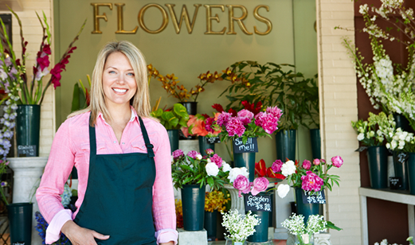
Hello, I’m Joanne
Hello, I’m Mary
Hi, My name’s Andrew
Where should they go ?
Hi, I’m Donna.
I’m a florist. Welcome to my flowers shop.
Hello, I’m John

Slide 29


Andrew studies tribes around the world. He likes mountain-climbing. Where should he go?
A. Sa Pa
B. Da Lat
C. Nha Trang
D. Ha Long Bay

Slide 30
Mary loves Viet Nam and she wants to travel by train to see as much of the country as possible. She also wants to visit an oceanic institute in Viet Nam. Where should she go?
A. Nha Rong Harbor
B. Nha Trang
C. Ha Long Bay
D. Da Lat

Slide 31
John is interested in history of Viet Nam. He wants to visit the place where President Ho Chi Minh left Viet Nam in 1911. Where should he go?
A. Ha Long Bay
B. Sa Pa
C. Nha Rong Harbor
D. Da Lat

Slide 32
Joanne likes swimming and sunbathing. She has been to Viet Nam twice and she has visited Nha Trang already. Where should she go?
A. Da Lat
B. Nha Rong Harbor
C. Nha Trang
D. Ha Long Bay

Slide 33
Donna is a florist. She has a flower shop in Los Angeles. She is thinking of importing flowers from Viet Nam. Where should she go?
A. Nha Trang
B. Sa Pa
C. Da Lat
D. Ha Long Bay

Slide 34
 | Nha Trang | Da Lat | Sa pa | Ha Long Bay | Nha Rong Harbor
a, Andrew studies tribes around the world. He likes mountain-climbing.
b, Mary loves Viet Nam and she wants to travel by train to see as much of the country as possible. She also wants to visit an oceanic institute in Viet Nam.
c, John is interested in history of Viet Nam. He wants to visit the place where President Ho Chi Minh left Viet Nam in 1911.
d, Joanne likes swimming and sunbathing. She has been to Viet Nam twice and she has visited Nha Trang already.
e, Donna is a florist. She has a flower shop in Los Angeles. She is thinking of importing flowers from Viet Nam.
✓
✓
✓
✓
✓

Slide 35
Da Lat
Nha Trang
Which place do you like to visit this summer vacation? Why?
Ha Long bay
Sa Pa

Slide 36
Homework
Learn by heart the new words and make sentences with them.
Do exercises in the workbook.
Prepare for the next lesson.

Slide 37
Thanks for your attention!

